Slide 1
GNA HACKATHON 4.0 - 2026
TITLE PAGE
Team ID- SE004
Team Leader Name –Trishal Gara
Team Name – CrackX
Problem Statement Title - Develop Effective Career Counselling and Guidance Programs in Schools to Enhance Student Career Choices
Theme- Smart Education

Slide 2
IDEA TITLE
LOGRA : UNLOCK YOUR POTENTIAL.
DEFINE YOUR CAREER.
……………….
AI-Powered Career Counselling for Better Decisions
Using Technology to Shape Student Futures
Smart Career Guidance with Data-Driven Insights
Personalized Career Paths through Intelligent Systems

Slide 3
INTRODUCTION
Career counselling plays a crucial role in helping students choose the right career path.
Many students face confusion due to lack of awareness, guidance, and exposure.
Traditional counselling methods in schools are often limited and not personalized.
With rapid changes in career options, students need smarter and updated guidance.
Our solution aims to provide technology-driven, personalized career counselling to help students make informed decisions.

Slide 4
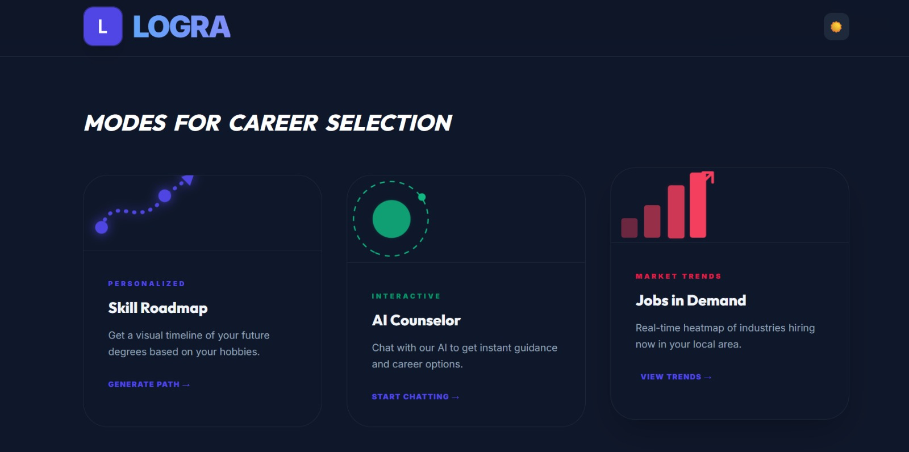
WEBSITE LAYOUT
GNA HACKATHON- | 4.0

Slide 5
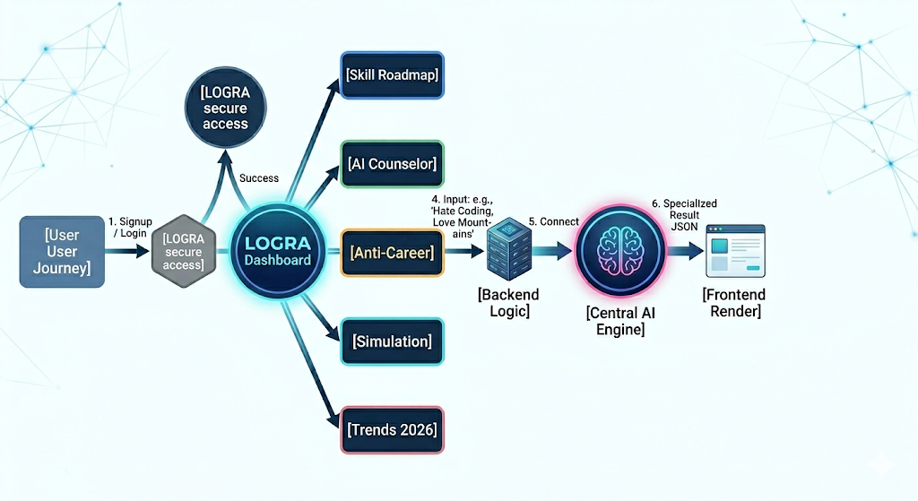
WEBSITE FLOWCHART
GNA HACKATHON- | 4.0

Slide 6
TECHNICAL APPROACH/ METHODOLOGY
1. Frontend (User Interface)
HTML, CSS, JavaScript (Tailwind CSS)
Interactive dashboard (LOGRA UI)
Career quiz, chatbot, roadmap view
2. Backend (Server Side)
Python (Flask Framework)
Handles user data, logic & processing
Connects frontend with database
3. Database
SQLite / MySQL Stores:
User profiles
Interests & responses
Career data
4. AI & Smart System
Recommendation System (career suggestions)
Data analysis for personalized results
5. APIs Integration
Career data APIs
Future: AI chatbot integration
6. Working Flow (VERY IMPORTANT)
Data Processing (backend + AI)
Career Recommendation
Personalized Roadmap

Slide 7
FEASIBILITY AND VIABILITY
FEASIBILITY (Can we build it?)
Uses existing technologies (HTML, CSS, JS, Python)
Easy integration of AI tools (AI recommendation system)
Low cost (open-source tools)
Simple and user-friendly system
Easy to implement in schools
VIABILITY (Will it work in real world?)
High demand for career guidance
Large number of students (target users)
Solves real-life problem (career confusion)
Scalable as a product/startup
Can be adopted by schools and institutions

Slide 8
IMPACT AND BENEFITS
For Students
Clear career direction
Reduced confusion and stress
Better decision making
Awareness of different career options
For Schools
Improved student performance
Better career guidance system
Increased success rate of students
Enhances school reputation
For Society
Skilled and career-ready youth
Reduced unemployment
Better workforce development
Positive impact on economy

Slide 9
RESEARCH AND REFERENCES
Google Research Articles on Career Guidance
National Career Service website
NCERT Career Guidance Resources
ChatGPT (for idea generation & content support)
Tailwind CSS Documentation (for UI design)
Flask Documentation (for backend development)

